Slide 1
Programming with R
Prepared by,
MS.S.S.NACHIYA , M.C.A., M.Phil.,UGC-NET
ASST. PROF. IN COMPUTER SCIENCE,
SHRIMATI INDIRA GANDHI COLLEGE,
TIRUCHIRAPPALLI - 2

Slide 2
Introduction
R is a popular programming language used for statistical computing and graphical presentation.
Its most common use is to analyze and visualize data.
It is easy to draw graphs in R, like pie charts, histograms, box plot, scatter plot,
etc++
It works on different platforms (Windows, Mac, Linux)
It is open-source and free
It has a large community support
It has many packages (libraries of functions) that can be used to solve different
problems.

Slide 3
R Variables
A variable is a memory allocated for the storage of specific data and the name associated with the variable is used to work around this reserved block.
Syntax
Using equal to operators variable_name = value
using leftward operator variable_name <- value
using rightward operator value -> variable_name

Slide 4
Example
# using equal to operator
var1 = "hello"
print(var1)
# using leftward operator
var2 <- "hello"
print(var2)
# using rightward operator
"hello" -> var3
print(var3)
Output
[1] "hello"
[1] "hello"
[1] "hello"

Slide 5
Data Structures
in R

Slide 6
The most essential data structures used in R include:
Vectors
Lists
Dataframes
Matrices
Arrays
Factors

Slide 7
Vectors
Vector is one of the basic data structures in R. It is homogenous, which means that it only contains elements of the same data type. Data types can be numeric, integer, character, complex, or logical.
Example
# Vectors(ordered collection of same data type)
X = c(1, 3, 5, 7, 8)
# Printing those elements in console
print(X)
Output
[1] 1 3 5 7 8

Slide 8
Lists
A list is a non-homogeneous data structure, which implies that it can contain elements of different data types. It accepts numbers, characters, lists, and even matrices and functions inside it. It is created by using the list() function.
Example
empId = c(1, 2, 3, 4)
empName = c("Debi", "Sandeep", "Subham", "Shiba")
numberOfEmp = 4
empList = list(empId, empName, numberOfEmp)
print(empList)
Output
[[1]] [1] 1 2 3 4
[[2]] [1] "Debi" "Sandeep" "Subham" "Shiba” [[3]]
[1] 4

Slide 9
Matrices
A matrix is a rectangular arrangement of numbers in rows and columns. In a matrix, as we know rows are the ones that run horizontally and columns are the ones that run vertically. Matrices are two-dimensional, homogeneous data structures.
Example
M1 <- matrix(c(1:9), nrow = 3, ncol =3, byrow= TRUE)
print(M1)
Output
[,1] [,2] [,3]
[,1] 1 2 3
[,2] 4 5 6
[,3] 7 8 9

Slide 10
Arrays
Arrays refer to the type of data structure that is used to store multiple items of a similar type together. This leads to a collection of items that are stored at contiguous memory locations. This memory location is denoted by the array name. The position of an element can be calculated simply by adding an offset to its base value.
Example
Array Structure
An array consists of the following:
Array Index: The array index identifies the location of the element. The array index starts with 0.
Array Element: Array elements are items that are stored in the array.
Array Length: The array length is determined by the number of elements that can be stored by the array. .

Slide 11
There are two types of arrays:
One-dimensional Arrays
Multi-dimensional Arrays
One-dimensional Arrays
One- or single-dimensional arrays are the types of arrays that have array elements stored in a sequence and can be accessed in the same order.
Multi-dimensional Arrays
Multi-dimensional arrays are arrays that have elements stored in more than one dimension. They can be two- or three-dimensional arrays and can consist of row and column indexes.
To create an array in R:
The array() function is utilised.
In this function, the input is a vector.
For creating the array, the value in the dim parameter is utilised.

Slide 12
For example:
In this following example, we will create an array in R of two 3×3 matrices each with 3 rows and 3 columns.
# Create two vectors of different lengths.
> vec1 <- c(1,2,4) #Author DataFlair
> vec2 <- c(15,17,27,3,10,11)
> output <- array(c(vec1,vec2),dim = c(3,3,2))

Slide 13
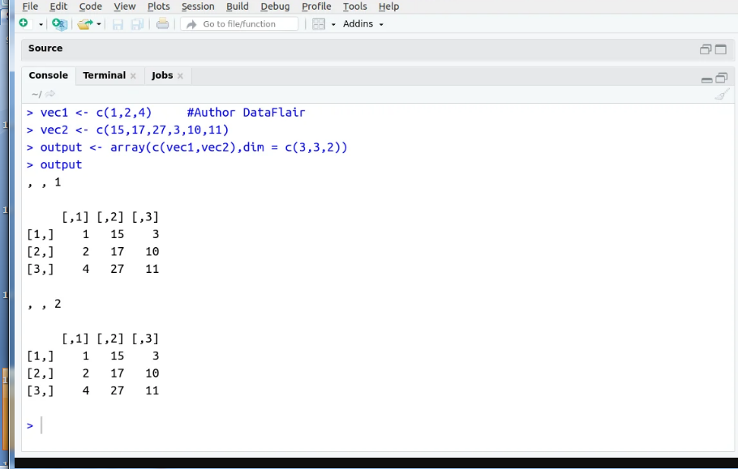
Output

Slide 14
Data Frames
A data frame is a two-dimensional array-like structure, or we can say it is a table in which each column contains the value of one variable, and row contains the set of value from each column.
There are the following characteristics of a data frame:
The column name will be non-empty.
The row names will be unique.
A data frame stored numeric, factor or character type data.
Each column will contain same number of data items.
To create a data frame we use the data.frame() function.

Slide 15
R program to illustrate dataframe
# A vector which is a character vector
Name = c("Amiya", "Raj", "Asish")
# A vector which is a character vector
Language = c("R", "Python", "Java")
# A vector which is a numeric vector
Age = c(22, 25, 45)
# To create dataframe use data.frame command
# and then pass each of the vectors
# we have created as arguments
# to the function data.frame()
df = data.frame(Name, Language, Age)
print(df)

Slide 16
Output:
Name Language Age
1 Amiya R 22
2 Raj Python 25
3 Asish Java 45

Slide 17
Factors
Factors are also data objects that are used to categorize the data and store it as levels. Factors can store both strings and integers. Columns have a limited number of unique values so that factors are very useful in columns. It is very useful in data analysis for statistical modeling.
Factors are created with the help of factor() function by taking a vector as an input parameter.

Slide 18
Example
# Create a vector as input.
data<- ("East","West","East","North","North","East","West","West","West","East","North")
print(data)
print(is.factor(data))
# Apply the factor function.
factor_data <- factor(data)
print(factor_data)
print(is.factor(factor_data))

Slide 19
Output
[1] "East" "West" "East" "North" "North" "East" "West" "West" "West" "East" "North" [1] FALSE
[1] East West East North North East West West West East North
Levels: East North West
[1] TRUE

Slide 20
Strings in R
A string is a sequence of characters. For example, "Programming" is a string that includes characters: P, r, o, g, r, a, m, m, i, n, g.
In R, we represent strings using quotation marks (double quotes, " " or single quotes, ' ').
For example
# string value using single quotes
'Hello‘
# string value using double quotes
"Hello"
Example: Strings in R
message1 <- 'Hola Amigos' print(message1)
message2 <- "Welcome to Programiz" print(message2)
Output
[1] "Hola Amigos“
[1] "Welcome to Programiz"

Slide 21
Example
a <- 'Start and end with single quote'
print(a)
b <- "Start and end with double quotes"
print(b)
c <- "single quote ' in between double quotes"
print(c)
d <- 'Double quotes " in between single quote'
print(d)
Output
[1] ‘Start and end with single quote’
[1] "Start and end with double quotes“
[1] "single quote ' in between double quote"
[1] ‘Double quote " in between single quote"

Slide 22
Join Strings Together
In R, we can use the paste() function to join two or more strings together.
For example
message1 <- "Programiz" message2 <- "Pro" # use paste() to join two strings paste(message1, message2)
Output
[1] Programiz Pro
Example
message1 <- "Hello, World!"
message2 <- "Hola, Mundo!“
message3 <- "Hello, World!“
# compare message1 and message2 print(message1 == message2)
# compare message1 and message3 print(message1 == message3)
Output
[1] FALSE
[1] TRUE

Slide 23
R Looping
Loops are used to repeat the process until the expression (condition) is TRUE. R uses three keywords for, while and repeat for looping purpose. Next and break, provide additional control over the loop.
The break statement exits the control from the innermost loop. The next statement immediately transfers control to return to the start of the loop and statement after next is skipped.
The value returned by a loop statement is always NULL and is returned invisibly.
There are three types of loops in R programming:
For Loop
While Loop
Repeat Loop

Slide 24
For Loop in R
It is a type of control statement that enables one to easily construct an R loop that has to run statements or a set of statements multiple times. For R loop is commonly used to iterate over items of a sequence. It is an entry-controlled loop, in this loop, the test condition is tested first, then the body of the loop is executed, the loop body would not be executed if the test condition is false.
Syntax:
for (initialization_Statement; test_Expression; update_Statement)
{
// statements inside the body of the loop
}

Slide 25
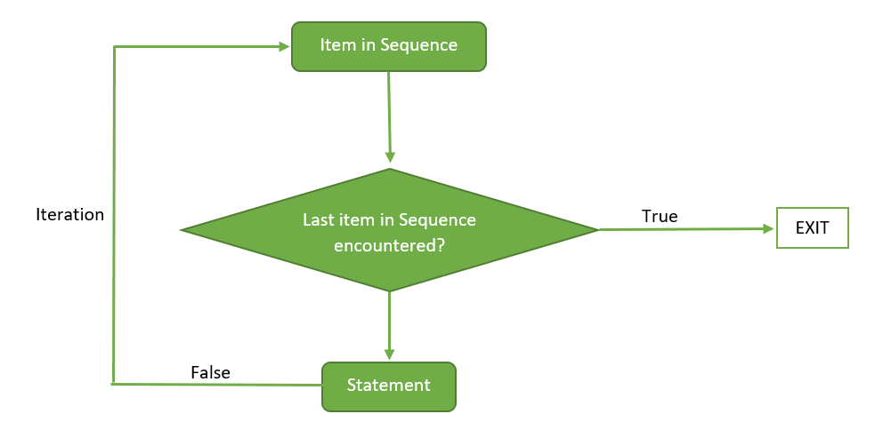
Flow Diagram:

Slide 26
Example 1: Program to display numbers from 1 to 5 using for loop in R
fruits<-list("apple","banana","cherry") for(x in fruits)
{
print(x) }
Output
[1] “apple”
[1] “banana”
[1] “cherry” anana" [1] "cherry«[1]{
[1] [1] "apple[1] "apple" [1] "banana" [1] "cherry[1] "apple"
[1] "banana"
[1] "cherry""" [1] "banana" [1] "cherry""apple" [1] "banana" [1] "cherry"

Slide 27
While Loop in R
It is a type of control statement that will run a statement or a set of statements repeatedly unless the given condition becomes false. It is also an entry-controlled loop, in this loop, the test condition is tested first, then the body of the loop is executed, the loop body would not be executed if the test condition is false.
Syntax:
while (expression)
{
statement
}

Slide 28
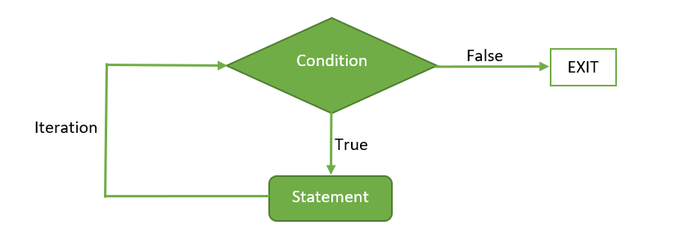
Flow Diagram:

Slide 29
Example: Print i as long as i is less than 6
i <- 1
while (i < 6) {
print(i)
i <- i + 1
}
Output
[ 1[[ [1] 1 [1] 2
[1] 3
[1] 4
[1] 5 [1] 4 [1] 5

Slide 30
Repeat loop
A repeat loop is used to iterate a block of code. It is a special type of loop in which there is no condition to exit from the loop. For exiting, we include a break statement with a user-defined condition. This property of the loop makes it different from the other loops.
A repeat loop constructs with the help of the repeat keyword in R. It is very easy to construct an infinite loop in R.
Syntax:
repeat {
commands
if(condition) {
break } }

Slide 31
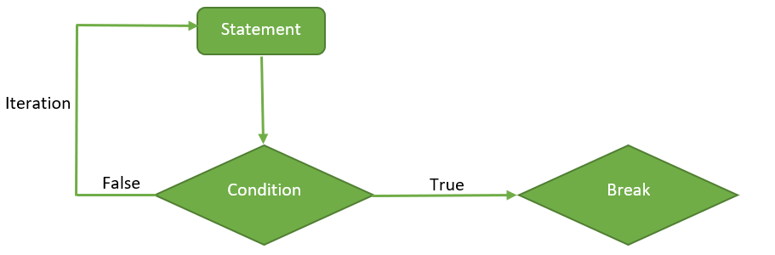
Flow Diagram:

Slide 32
Example
v <- c("Hello","repeat","loop")
cnt <- 2
repeat {
print(v)
cnt <- cnt+1
if(cnt > 5)
{
break
}
}

Slide 33
Output:
[1] “Hello” “repeat” “loop”
[1] “Hello” “repeat” “loop”
[1] “Hello” “repeat” “loop”
[1] “Hello” “repeat” “loop”

Slide 34
Packages in R
R packages are a collection of R functions, complied code and sample data. They are stored under a directory called "library" in the R environment. By default, R installs a set of packages during installation. More packages are added later, when they are needed for some specific purpose. When we start the R console, only the default packages are available by default.
Other packages which are already installed have to be loaded explicitly to be used by the R program that is going to use them.

Slide 35
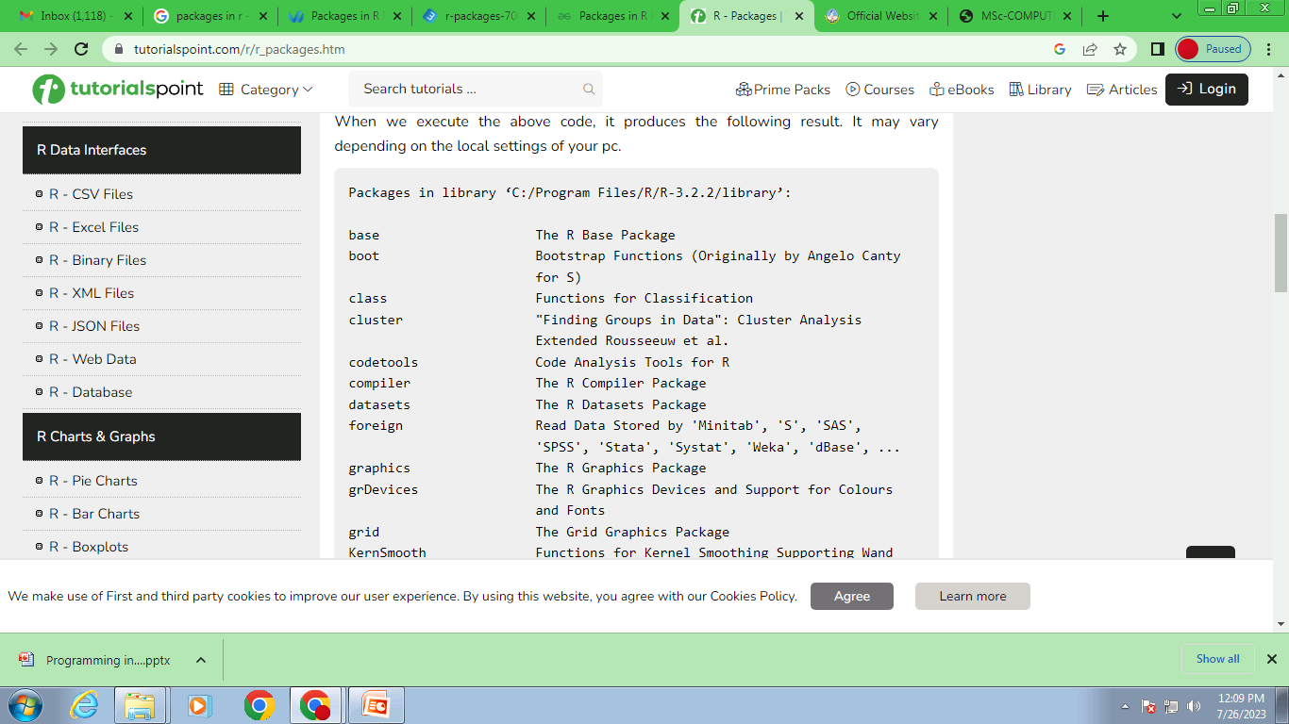
Loading packages in R
For loading a package which is already existing and installed on your system, you can make use of and call the library function.
Example
>library()
To execute the above code snippet will produce the following result

Slide 36
Get all packages currently loaded in the R environment
>search()
To execute the above code will produce the following result
[1] ".GlobalEnv" "package:stats" "package:graphics"
[4] "package:grDevices" "package:utils" "package:datasets"
[7] "package:methods" "Autoloads" "package:base"
Install a New Package
There are two ways to add new R packages. One is installing directly from the CRAN directory and another is downloading the package to your local system and installing it manually.
Install directly from CRAN
The following command gets the packages directly from CRAN webpage and installs the package in the R environment.
install.packages("Package Name") # Install the package named "XML". install.packages("XML")

Slide 37
Install package manually
Go to the link R Packages to download the package needed. Save the package as a .zip file in a suitable location in the local system.
Now you can run the following command to install this package in the R environment.
install.packages(file_name_with_path, repos = NULL, type = "source")
# Install the package named "XML“
install.packages("E:/XML_3.98-1.3.zip", repos = NULL, type = "source")

Slide 38
Load Package to Library
Before a package can be used in the code, it must be loaded to
the current R environment. You also need to load a package that is already
installed previously but not available in the current environment.
A package is loaded using the following command −
>library("package Name", lib.loc = "path to library")
# Load the package named "XML“
install.packages("E:/XML_3.98-1.3.zip", repos = NULL, type = "source")

Slide 39
Maintaining packages in R
After your packages get installed and you frequently want to update them in order to have an up to date latest versions. This is possible using update.packages. By default, the function will remind you to update each package.
update.packages (ask = FALSE)
# this won't ask for package updating
It may happen that you may want to delete any package. It is possible using the remove.packages().
Example:
remove.packages("zoo")

Slide 40
Dates and Times in R
Depending on what purposes we're using R for, we may want to deal with data containing dates and times.
R Provides us various functions to deal with dates and times.
Get Current System Date, and Time in R
In R, we use Sys.Date(), Sys.time() to get the current date and time respectively based on the local system.
For example
# get current system date Sys.Date()
# get current system time Sys.time()
Output
[1] "2022-07-11”
[1] "2022-07-11 04:16:52 UTC"

Slide 41
Using R lubridate Package
The lubridate package in R makes the extraction and manipulation of some parts of the date value more efficient.
There are various functions under this package that can be used to deal with dates.
But first, in order to access the lubridate package, we first need to import the package as:
# access lubridate package library(lubridate)
1.Get Current Date Using R lubridate Package
# access lubridate package library(lubridate)
# get current date with time and timezone now()
# Output: "2022-07-11 04: 34: 23 UTC"

Slide 42
2. Extraction Years, Months, and Days from Multiple Date Values in R
In R, we use the year(), month(), and mday() function provided by the lubridate package to extract years, months, and days respectively from multiple date values.
For example,
# import lubridate package library(lubridate)
dates <- c("2022-07-11", "2012-04-19", "2017-03-08")
# extract years from dates year(dates)
# extract months from dates month(dates)
# extract days from dates mday(dates)

Slide 43
Output
[1] 2022 2012 2017
[1] 7 4 3
[1] 11 19 8
Here,
year(dates) - returns all years from dates i.e. 2022 2012 2017
month(dates) - returns all months from dates i.e. 7 4 3
mday(dates) - returns days from dates i.e 11 19 8

Slide 44
Files in R
In the R programming language, we deal with large amounts of data by representing data in files. In this regard, we can perform certain operations to access data like creating files, reading files, renaming them, etc.
Some different file operations in R are:
Creation of files
Writing to the files
Reading data from a file
Check the existing status of a file
Renaming the existing files

Slide 45
Creation of a file
Using file.create() function, a new file can be created from console or truncates if already exists.
Syntax: file.create(” “)
# Create a file
if (file.create("GFG.txt")
print(‘Congrats! Your File Has been created.’)
else
print(‘unable to create’)
Output :[1] "Congrats! Your File Has been created."

Slide 46
Writing to the files
write.table() function in R programming is used to write an object to a file.
Syntax: write.table(x, file)
Parameters:
x: indicates the object that has to be written into the file file: indicates the name of the file that has to be written
Example
# into the txt file
write.table(x=toothgrowth[1:10,],”CFG.TXT”)
data=read.table(”CFG.TXT”)
print(data) # printing data

Slide 47
Output len supp dose 1 4.2 VC 0.5 2 11.5 VC 0.5 3 7.3 VC 0.5 4 5.8 VC 0.5 5 6.4 VC 0.5 6 10.0 VC 0.5 7 11.2 VC 0.5 8 11.2 VC 0.5 9 5.2 VC 0.5 10 7.0 VC 0.5

Slide 48
Reading data from a file
After the writing data onto a file, we need to read the information from the file using
built-in function. We use the read.table() function to read the file’s content
that is passed as an argument.
Syntax: read.table(file)
Parameters: file: indicates the name of the file that has to be read
Example
# Reading txt file
new.iris <- read.table(file = "GFG.txt")
# Print
print(new.iris)

Slide 49
Output
X Sepal.Length Sepal.Width Petal.Length Petal.Width Species
1 1 5.1 3.5 1.4 0.2 setosa
2 2 4.9 3.0 1.4 0.2 setosa
3 3 4.7 3.2 1.3 0.2 setosa
4 4 4.6 3.1 1.5 0.2 setosa
5 5 5.0 3.6 1.4 0.2 setosa
6 6 5.4 3.9 1.7 0.4 setosa
7 7 4.6 3.4 1.4 0.3 setosa
8 8 5.0 3.4 1.5 0.2 setosa
9 9 4.4 2.9 1.4 0.2 setosa
10 10 4.9 3.1 1.5 0.1 setosa

Slide 50
Check an existing file
We can check the file if it exists or not within the current directory or on the
mentioned path using the file.exists() function. We need to pass the file name,
and if the file name is in existence, it returns TRUE. Otherwise, it returns FALSE.
Syntax
file.exists(“file_name”)
Example
if (file.exists(“CFG.TXT”))
{
print(‘Your file ‘CFG.TXT’ Exist!’)
}
else
{
print(‘Your file ‘CFG.TXT’ is unavailable’)
}
Output
[1] "Your File ` CFG.TXT ` Exist!"

Slide 51
Renaming a File
The file.rename() function renames the file and return a logical value.
The function renames files but not directories. It only alters the existing file’s name to a new name and returns TRUE after successful completion. If the file to rename is not found, it terminates with the FALSE value.
Syntax:
file.rename(from, to)
Parameters: from: indicates current file name or path to: indicates new file name or path
Example
# Rename file GFG.txt to newGFG.txt
file.rename("GFG.txt", "newGFG.txt")
Output
[1] TRUE

Slide 52
Making packages in R
Two libraries are required for making a package.
install.packages("devtools")
install.packages("roxygen2")
In RStudio, open File and select New Project and pick the option for R Package. Now name your project and pick where it will be saved.
Assume that we want to create an R package that includes two functions. The first function will convert temperatures from degrees Fahrenheit to degrees Celsius, while the second function will convert temperatures from degrees Celsius to degrees Fahrenheit. The first thing we need to do is create a new folder somewhere on our computer that will hold the whole R package

Slide 53
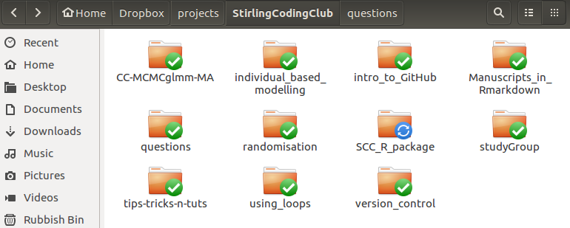
The above shows the new folder ‘SCC_R_package’. For now, this folder is empty. The first thing that we need to do is to create a new folder inside of ‘SCC_R_package’ called ‘R’.

Slide 54
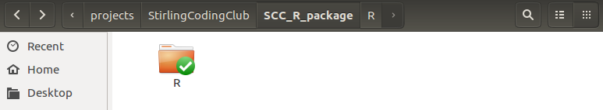
Inside this folder is where we will store the actual R scripts with the coded functions. Any number of ‘.R’ files can be included in the folder, and each file can have any number of functions. You could, for example, give each function its own file, or just have one file with many R functions

Slide 55
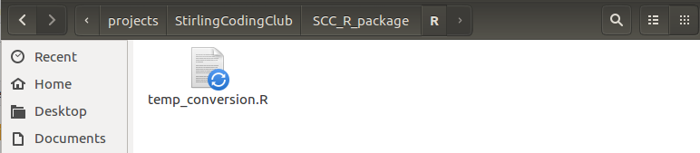
In our new R package, will write both functions in the same file called ‘temp_conversion.R’, which has the code below.
Copy contentsF_to_C <- function(F_temp)
{
C_temp <- (F_temp - 32) * 5/9; return(C_temp);
}
C_to_F <- function(C_temp)
{
F_temp <- (C_temp * 9/5) + 32; return(F_temp);
}
That is the whole file for now; just nine lines of code.

Slide 56
The next thing that we need to do is create a new file called DESCRIPTION in
the SCC_R_package directory (note, not in ‘R’, but just outside of it).
This will be a plain text file with no extension, and it will hold some of
the meta-data on the R package. For now, the whole file is just the following four
lines of code, specifying the package name, type, title, and version number.
Package: SCCTempConverter
Type: Package
Title: Temperature Conversion Package for Demonstration
Version: 0.0.1.0
If we really wanted to call it quits, this is technically an R package, albeit an extremely basic one. We could load it using the code above after first reading in the devtools library.
library(devtools);
load_all("."); # Working directory should be in the package SCC_R_package

Slide 57
Note that the working directory needs to be set correctly to the R package directory (e.g., using the setwd function, or by choosing Session > Set Working Directory from the pull down menu of RStudio). In doing this, the above functions F_to_C and C_to_F are now read into R and we can use them to convert temperatures.
F_to_C(79);
C_to_F(20);

